Slide 1

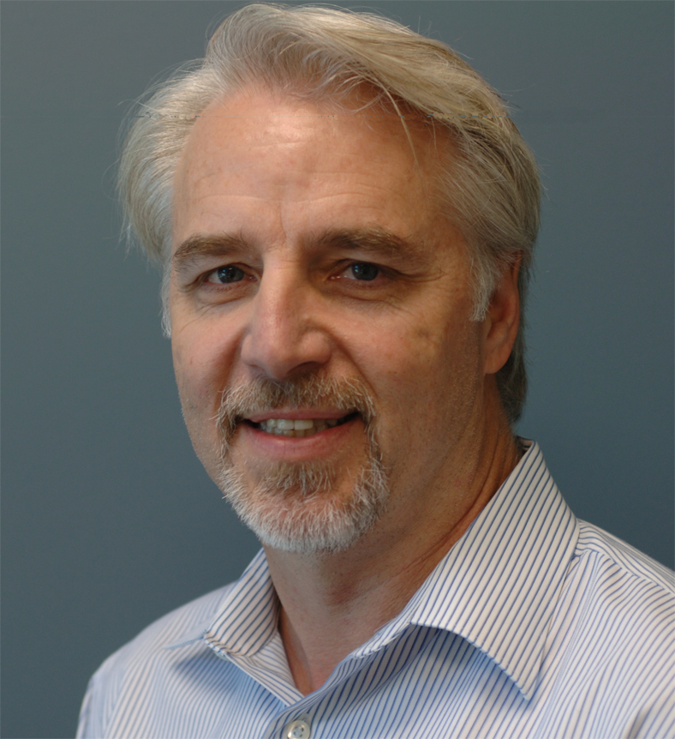

國立清華大學腦科學研究中心
NATIONAL TSING HUA UNIVERSITY
Brain Research Center
Special Seminar
Speaker: Prof. Tim Tully
Chief Science Officer
Dart NeuroScience_{LLC}
Title: Memory enhancers and mental retardation
Time: 15:30 p.m.~17:30 p.m., Thursday, Dec. 2, 2010
Place: Room 112, Life Science Building I
Host: Prof. Ann-Shyn Chiang
Language: English
Contact: Dr. Tzu-en Hua (03-5742478)

